Slide 1



Learning to Align Question and Answer Utterances in Customer Service Conversation with Recurrent Pointer Networks
Shizhu He¹, Kang Liu¹ and Weiting An²
¹National Laboratory of Pattern Recognition
Institute of Automation, Chinese Academy of Sciences
²Alibaba Group

Slide 2
Outline
Task
Introduction
Our Proposed Approach
Experiments

Slide 3
Outline
Task
Introduction
Our Proposed Approach
Experiments

Slide 4
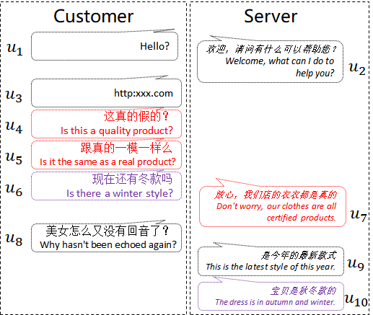
Customer Service Conversation
Customer Service Conversation
Customers ask questions;
Customer service staffs reply answers;
Multi-round conversation between two participants;
There are certain corresponding relations among conversation utterances；
No explicit alignment marks among those utterances.

Slide 5
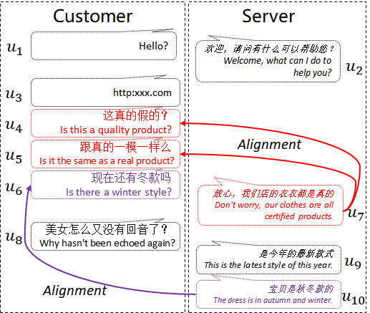
Utterance Alignment
Finding the alignments among utterances
Question Utterances (Customers)
Answer Utterances (Servers)
Align the question (Q) and answer (A) utterances
Applications
Analyze the consulting hot issues;
Perform quality control;
Automatically collect high-quality“aligned” question-answer pairs for training intelligent dialogue systems

Slide 6
Outline
Task
Introduction
Our Proposed Approach
Experiments

Slide 7
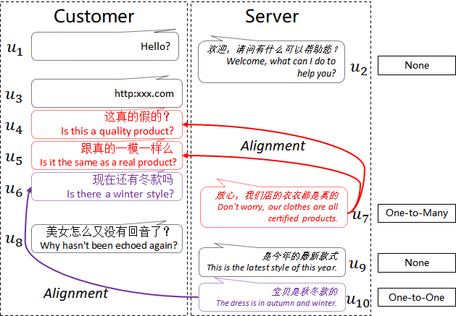
Utterance Alignment in Customer Service Conversation
The meaning of an utterance is context dependent.
The alignments of different utterances are correlating and interactional with each other.
There are various alignments of Q-A utterances in a CS conversation.

Slide 8
Utterance Alignment in Customer Service Conversation
Sequential decision task
Learn the meaning of utterances in conversation content
Utilize the mutual effects of different utterances and their alignments
Utterance match task
Align each answer utterance with previous question utterances
Recurrent Neural Network + Pointer Networks

Slide 9
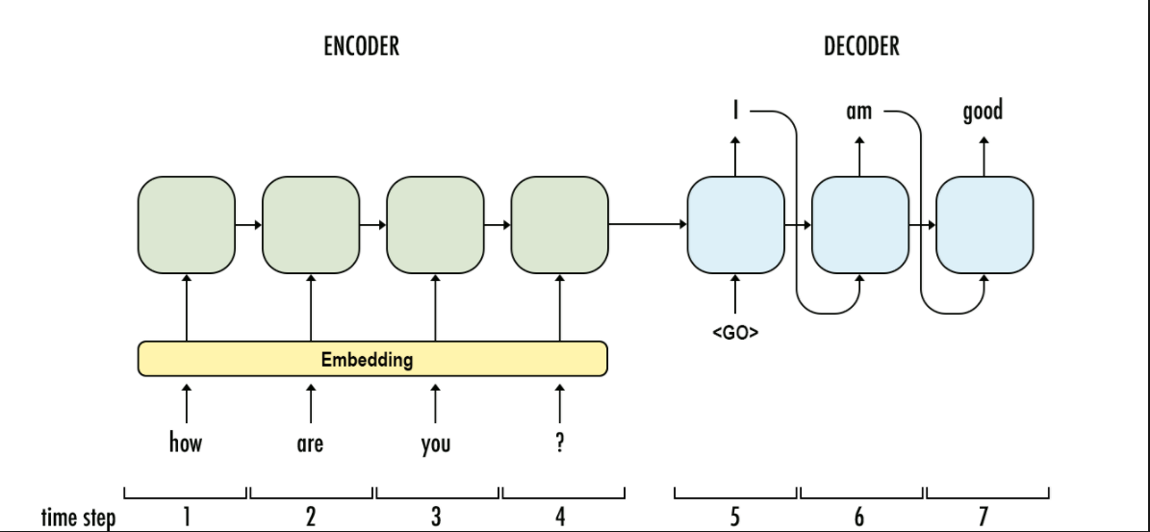
Background: Sequence to Sequence Learning
Vocab Classifier(e.g., 4W)
RNN(GRU,LSTM)
CNN
Transformer

Slide 10
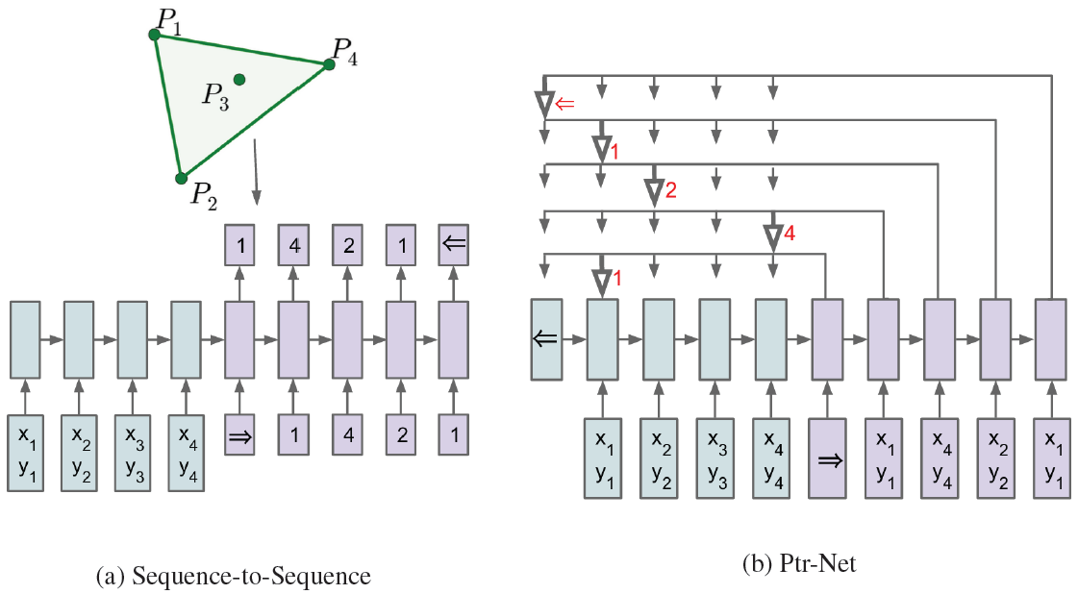
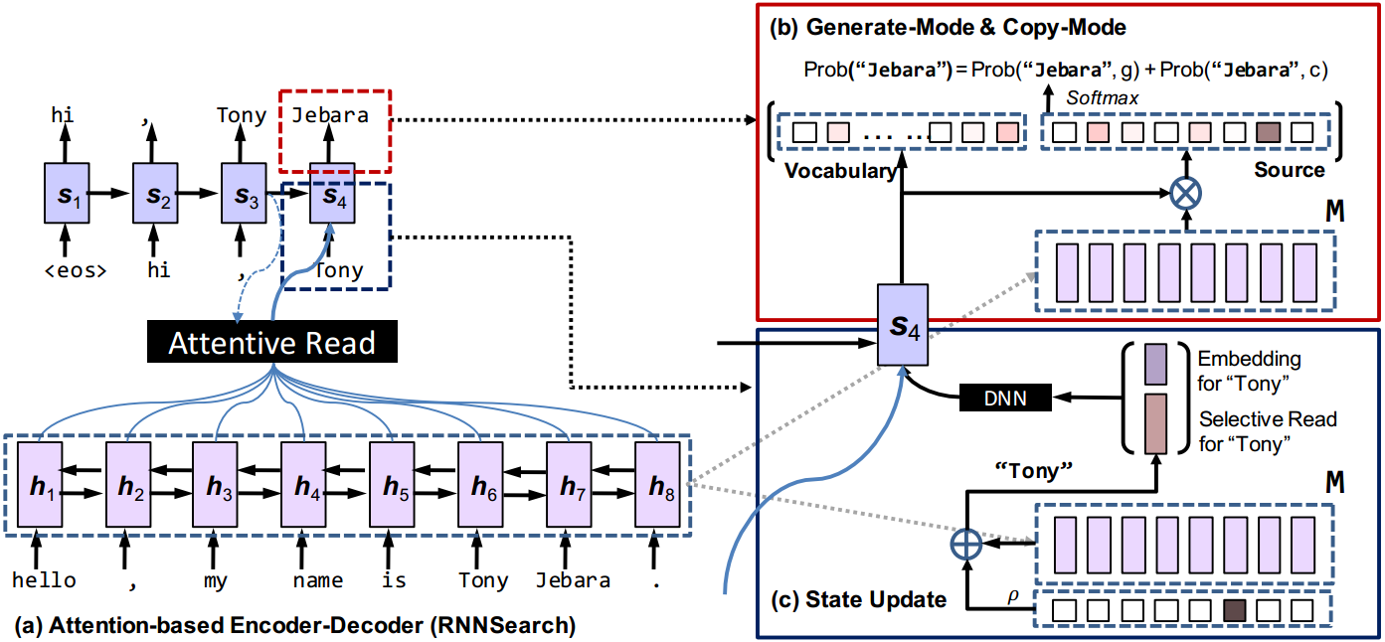
Background: Pointer Networks/Copy Mechanism
Pointer Networks [NIPS 2015]
Copy Mechanism [ACL 2016]

Slide 11
Outline
Task
Introduction
Our Proposed Approach
Experiments

Slide 12
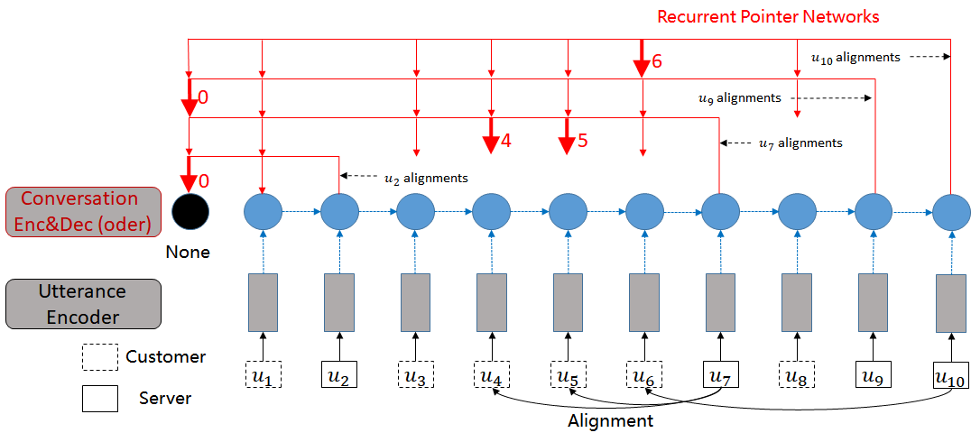
Main architecture：Model-I
Utterance Encoder
CNN
Conversation Encoder
RNN
Alignment Decoder

Slide 13
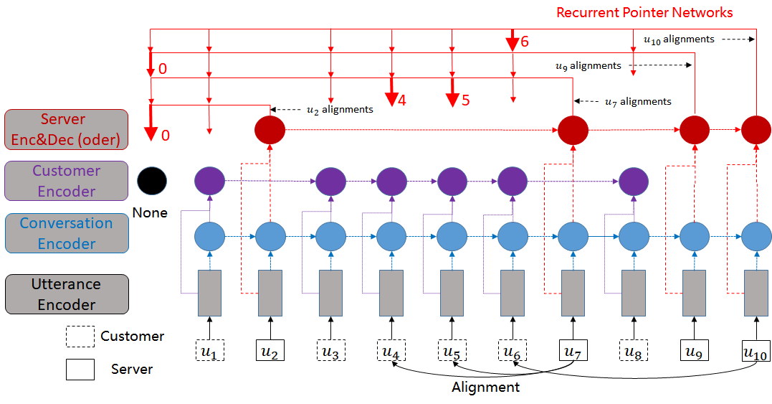
Main architecture：Model-II
Utterance Encoder
CNN
Conversation Encoder：RNN
Customer Encoder：RNN
Server Encoder：RNN
Alignment Decoder

Slide 14
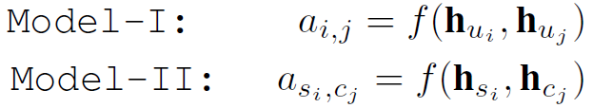
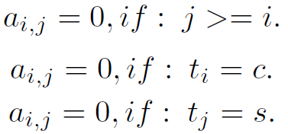

Alignment Decoder
Alignment score：bilinear function
Explicit rules：Mask vectors
$$f\left(h_{a},h_{b}\right)=h_{a}^{T}∙W∙h_{b}$$

Slide 15



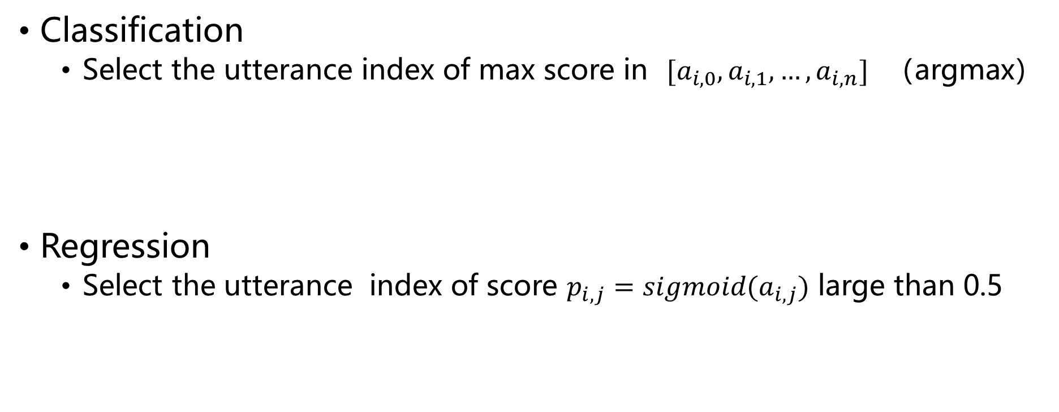
Alignment Decoder：Inference
Classification
Select the utterance index of max score in $[a_{i,0},a_{i,1},…,a_{i,n}]$ （argmax）
Regression
Select the utterance index of score $p_{i,j}=sigmoid(a_{i,j})$ large than 0.5

Slide 16
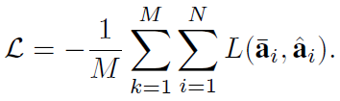


Alignment Decoder：Training
Loss Function
Classification Loss： cross-entropy
Regression Loss：MSE + L1 norm

Slide 17
Outline
Task
Introduction
Our Proposed Approach
Experiments

Slide 18
Experiments：Data
Conversations from in-house online CS
Sampling Conversations：own 6-20 utterances for each conversational episode
Human annotation: 5,741 labeled conversations (Fleiss’ Kappa was 0.523)
6.0 utterances of customers with 22.7 words
4.5 utterances of servers with 6.2 words
The answer is aligned with 1.38 questions on average
The alignments of None and One-to-Many account for 57% and 12%

Slide 19
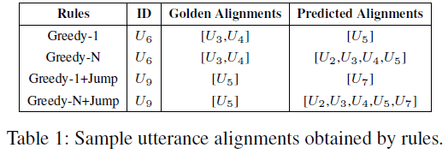
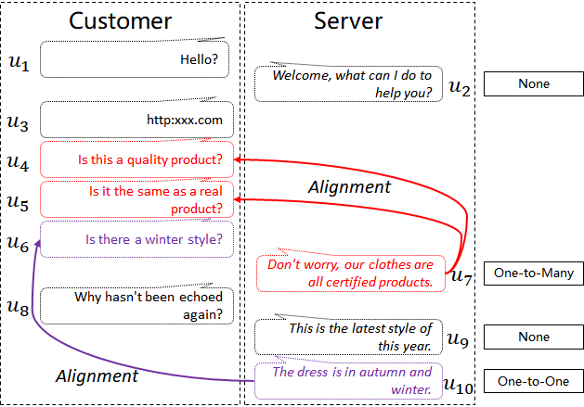
Experiments：Baselines
Rule-based methods
Match-base methods
Learning the matching function with DNN
Discriminative models (Du, Poupart, and Xu 2017)
Two-stage method (Jiang et al. 2018)

Slide 20
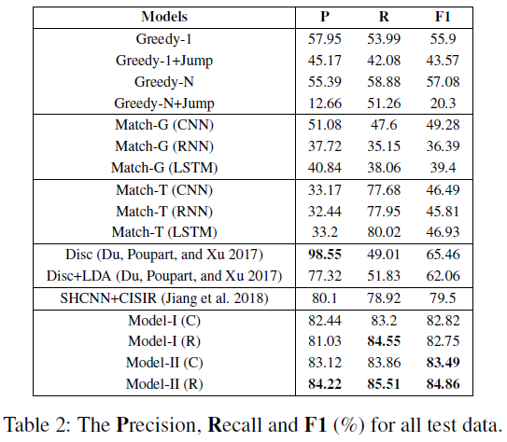
Experimental Results
Overall Performance

Slide 21
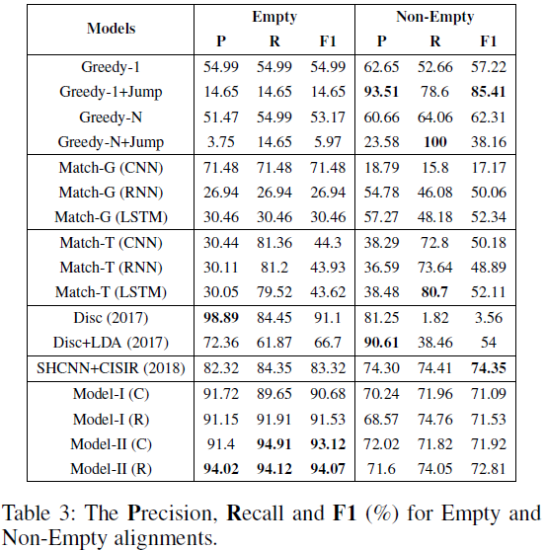
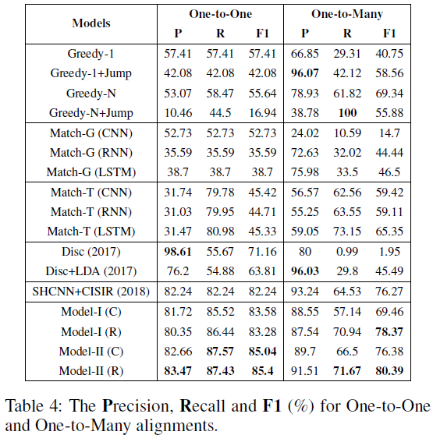
Experimental Results
None vs. Non-Empty
One-to-One vs. One-to-Many

Slide 22
Conclusion & Future work
A practical task: alignments of question and answer utterances in a CS conversation;
We propose two end-to-end models with recurrent pointer networks (RPN);
Able to model the conversational contexts and consider the mutual influence of different utterances
Address the issue of empty and multiple alignments for some answer utterances
Future work
Incorporating the goods’ knowledge information
Developing unsupervised or semi-supervised methods

Slide 23
Thanks！ shizhu.he@nlpr.ia.ac.cn

